Slide 1
DIGITIZED RTC
By
160120737065-Hafsa Zareen
160120737079-Srija Esampalli

Slide 2
TABLE OF CONTENTS
Introduction
Motivation
Objectives
Problem Statement
Flowchart
Implementation
Results
Conclusion
Future Scope
References

Slide 3
INTRODUCTION
The Telangana State Road Transport Corporation popularly known as TSRTC operates buses for local Travel as well as travel across states and cities. At the moment, we do not have a provision for taking bus ticket online for local travel.
Our website Digitized RTC is a platform for passengers in Hyderabad city to be able to take tickets in local buses and manage their travel plans for the day.
Digitized RTC is a unified interface for passengers to be able to connect from one part of the city to another.

Slide 4
MOTIVATION
We observe on a daily basis how difficult it is to travel in TSRTC within the city, we also observe how for bus conductors it is difficult to return chump change to passengers. This issue can be addressed with an online ticket issuing option.

Slide 5
PROBLEM STATEMENT
In today’s fast-paced digital world, people are being encouraged to use digital modes of payment in turn leading to a hassle free experience. As of now there is no provision for people to take tickets in online mode.

Slide 6
OBJECTIVE
The main objective of our project is to provide a platform for passengers where they can take TSRTC bus tickets through online mode in intracity as well.

Slide 7
FLOWCHART
Open DIGITIZED RTC
Take ticket
Enter source and destination
Submit
Pay the money
Choose payment method
Proceed to pay
Tap to scan QR for ticket
Notification of ticket confirmation
Scan QR

Slide 8
IMPLEMENTATION
The front-end languages used in implementing this website are HTML,CSS ,JAVASCRIPT
Text editor used is Visual Studio Code
The backend language used in storing the details of the logged in users is PHP

Slide 9
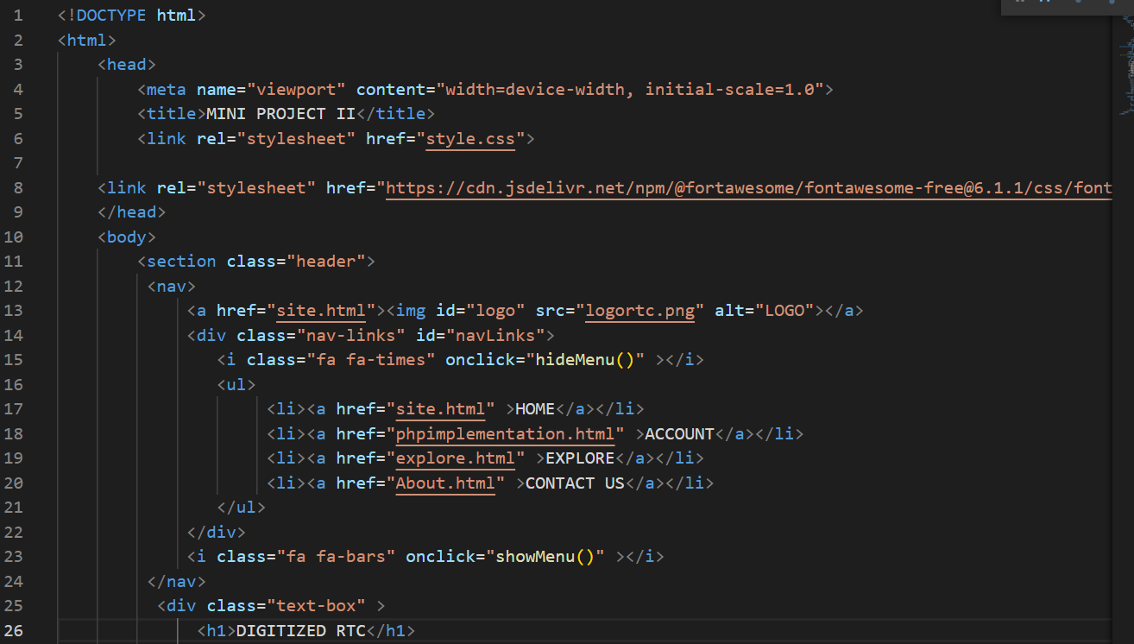

Slide 10
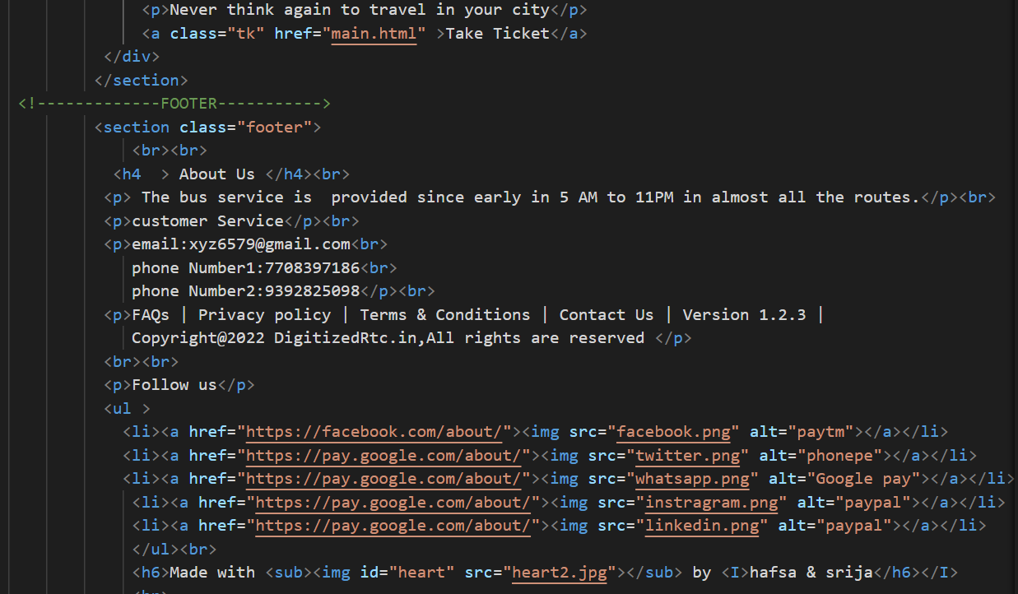

Slide 11
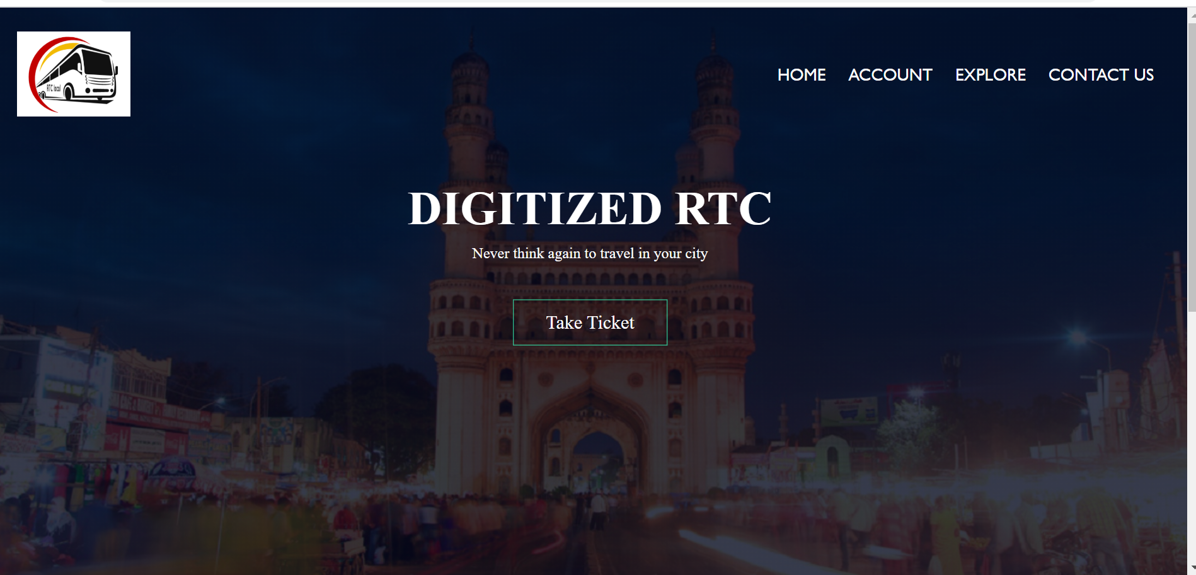
RESULTS

Slide 12
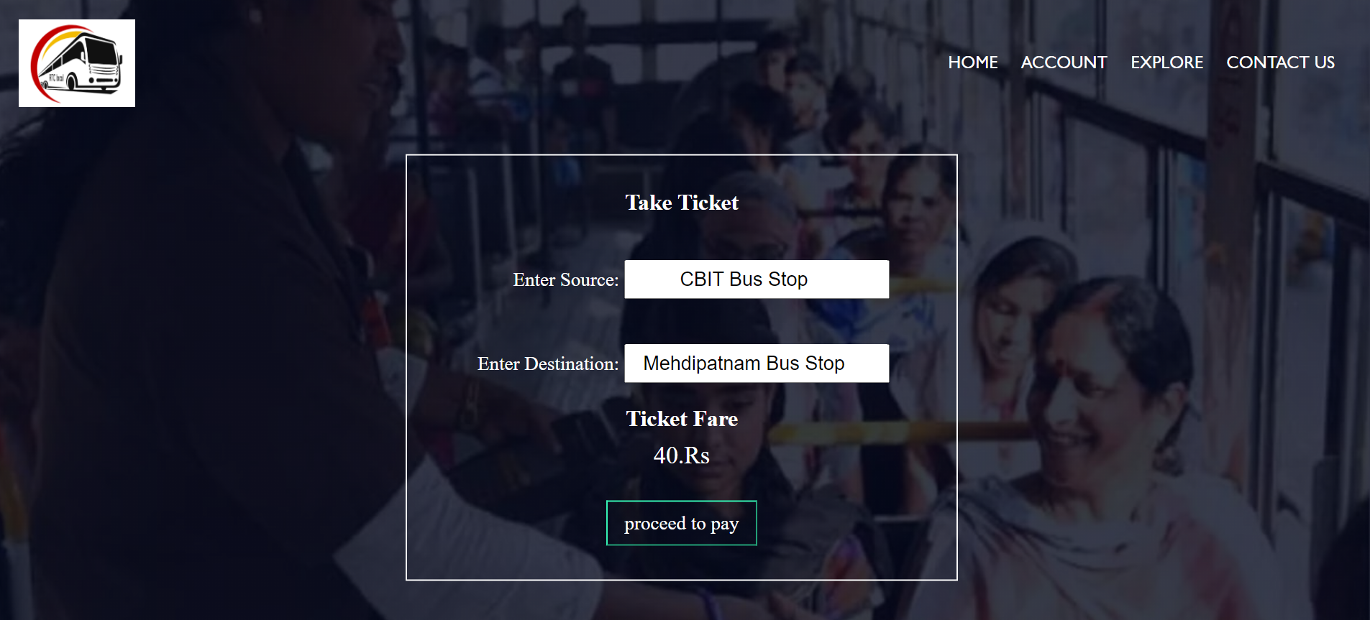

Slide 13
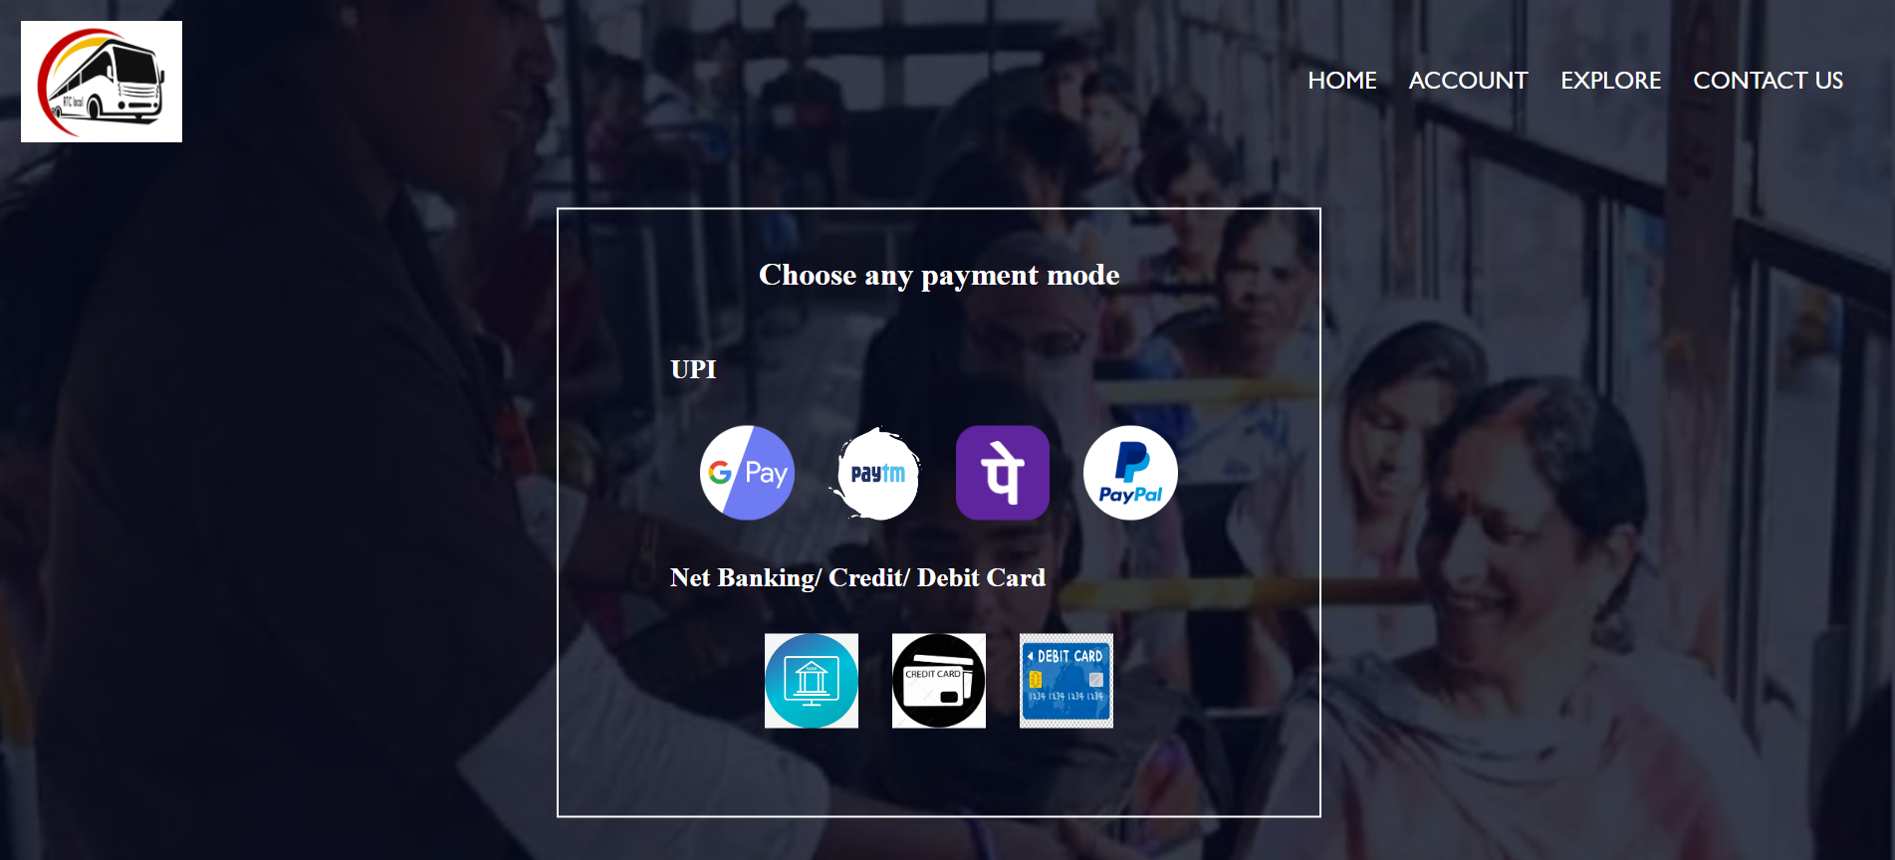

Slide 14
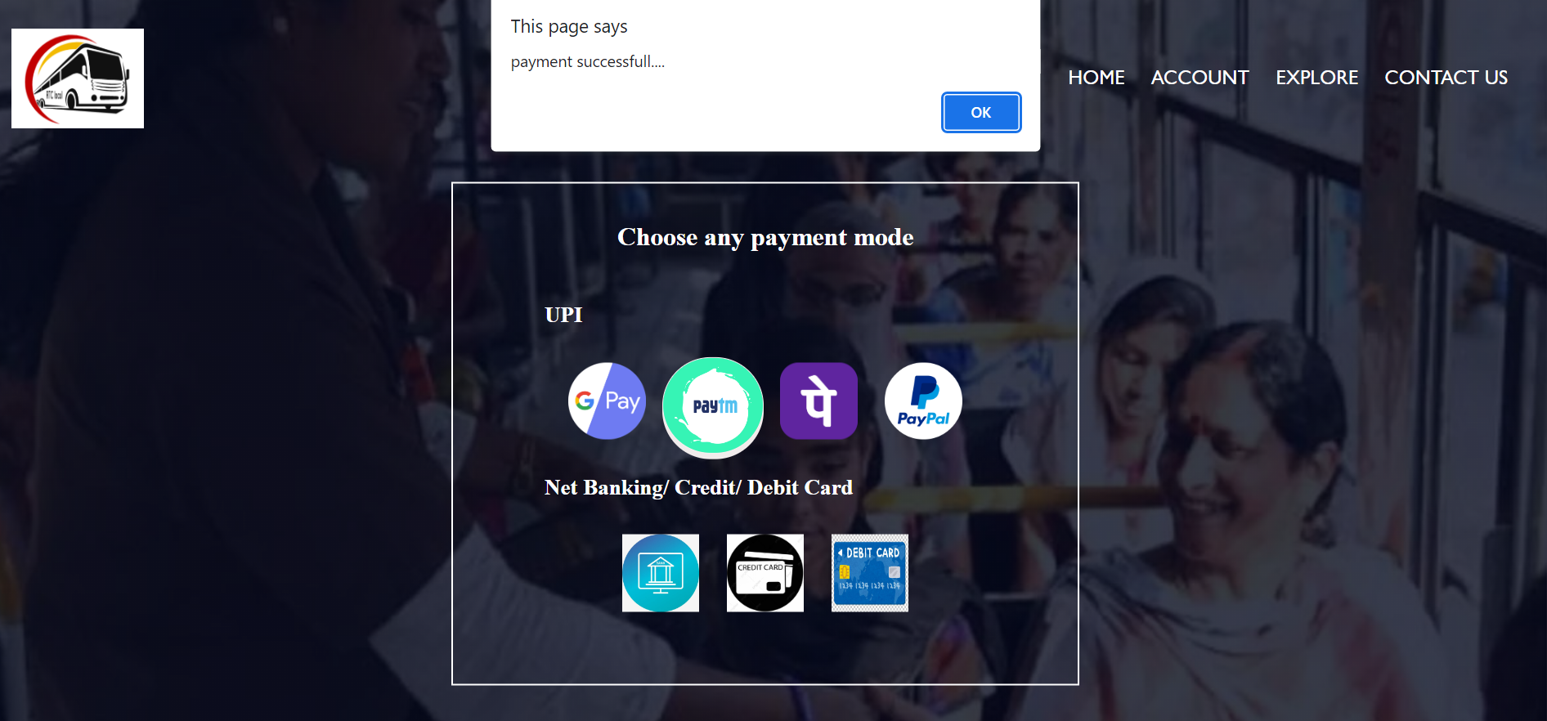

Slide 15
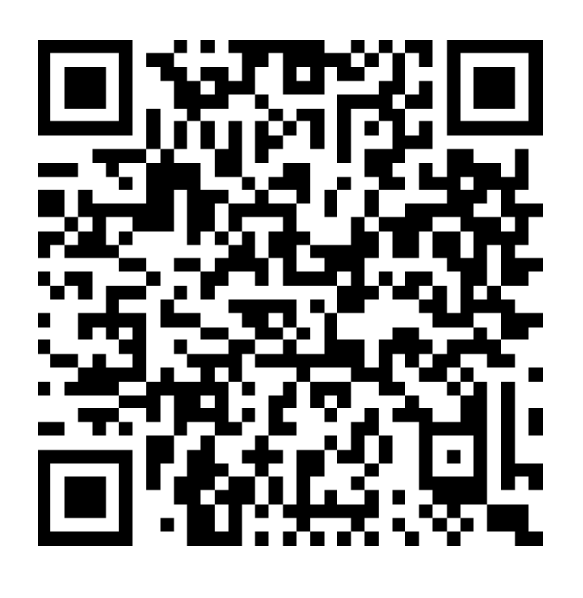
QR CODE to get ticket

Slide 16
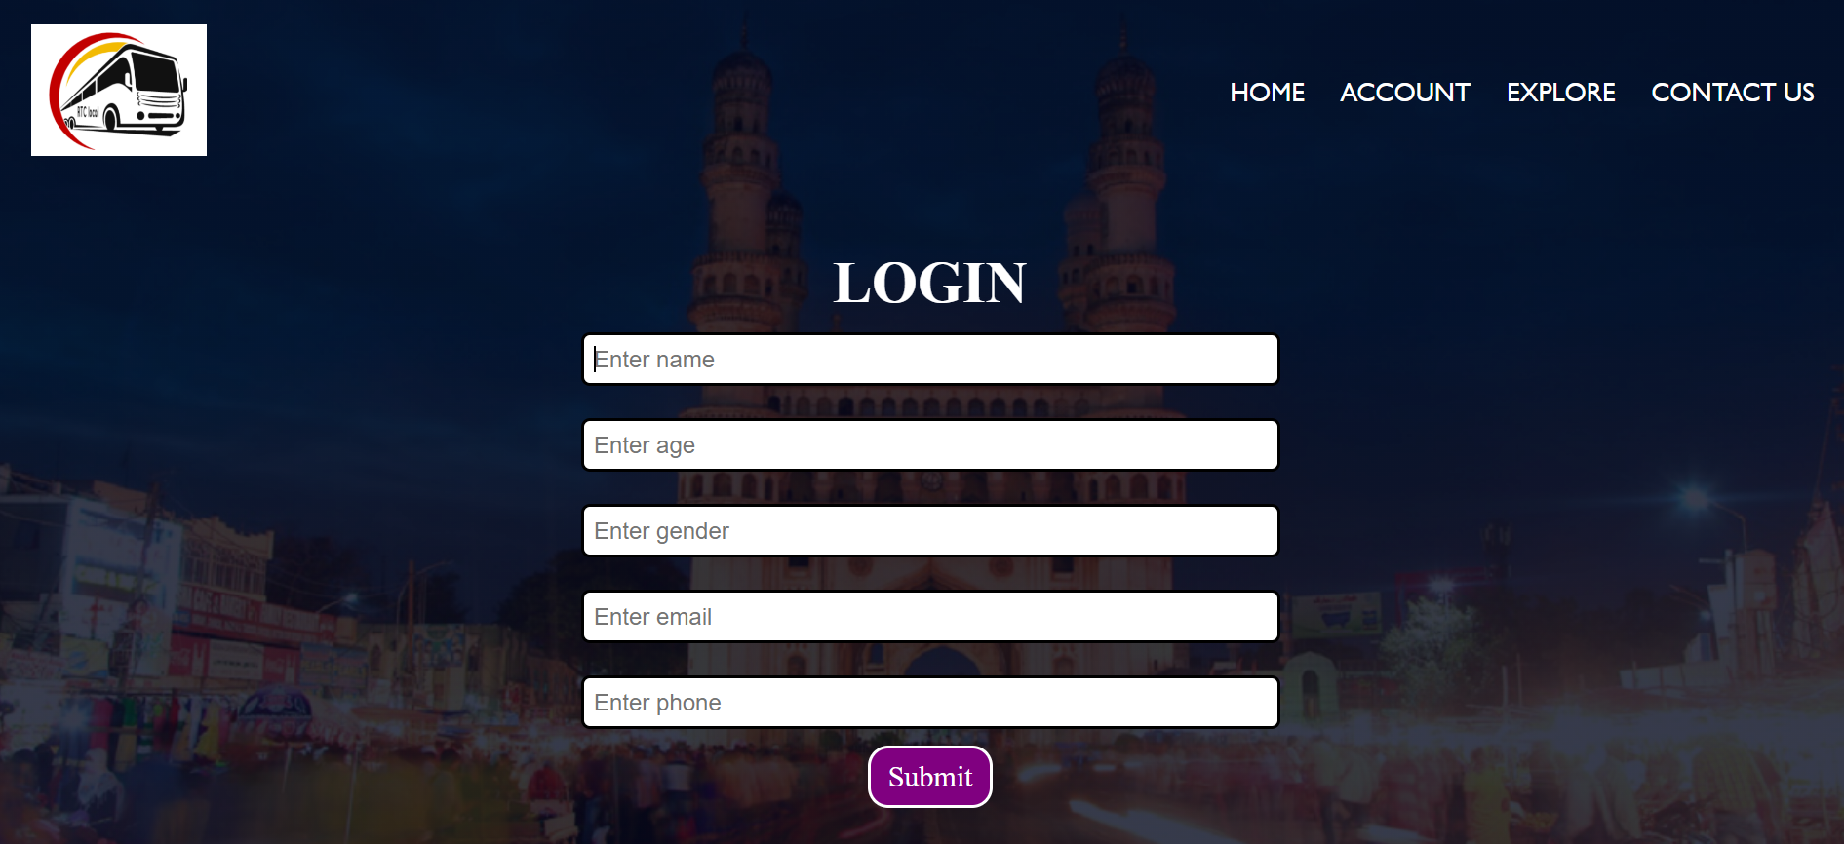

Slide 17
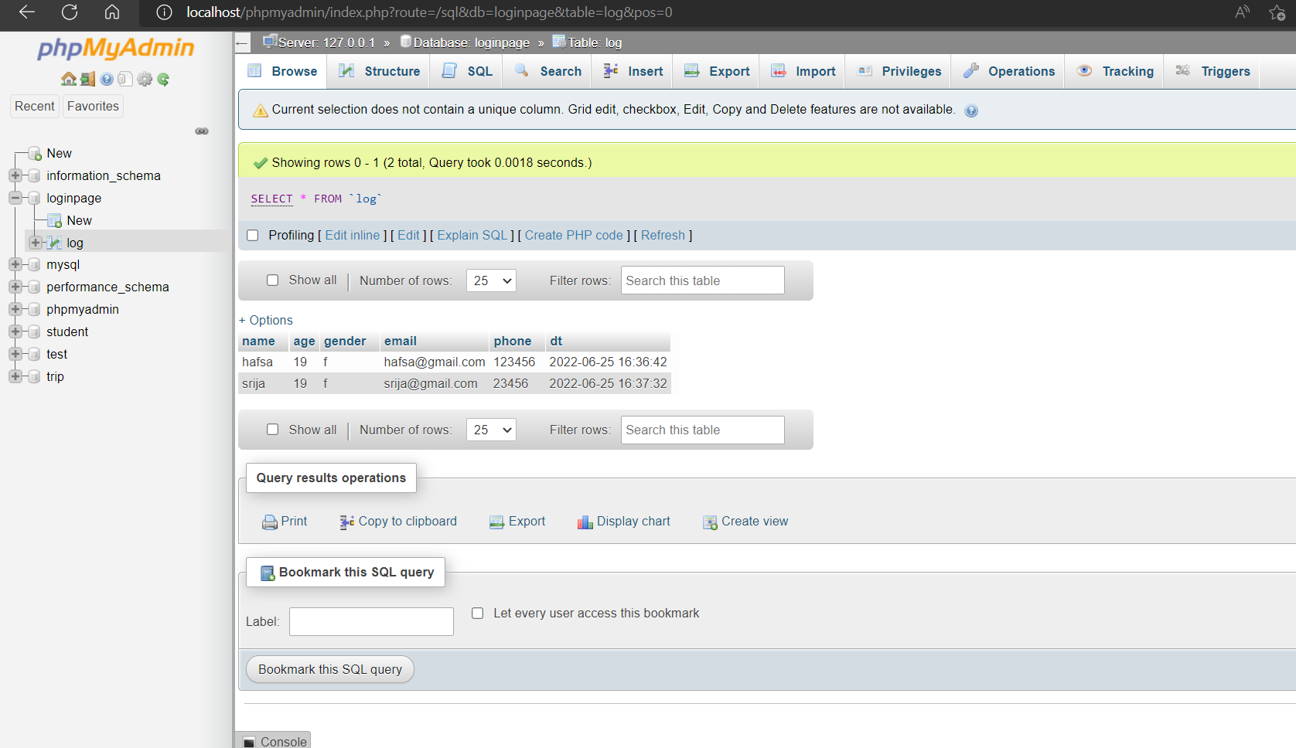

Slide 18
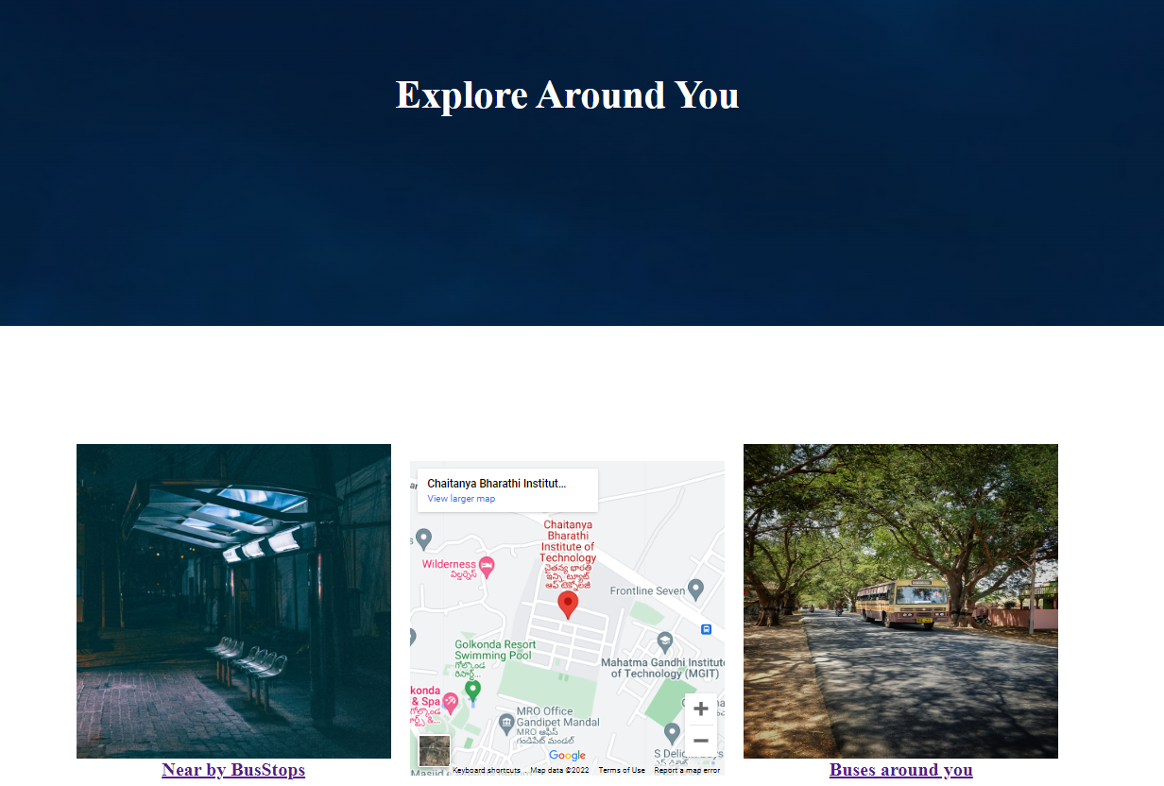

Slide 19
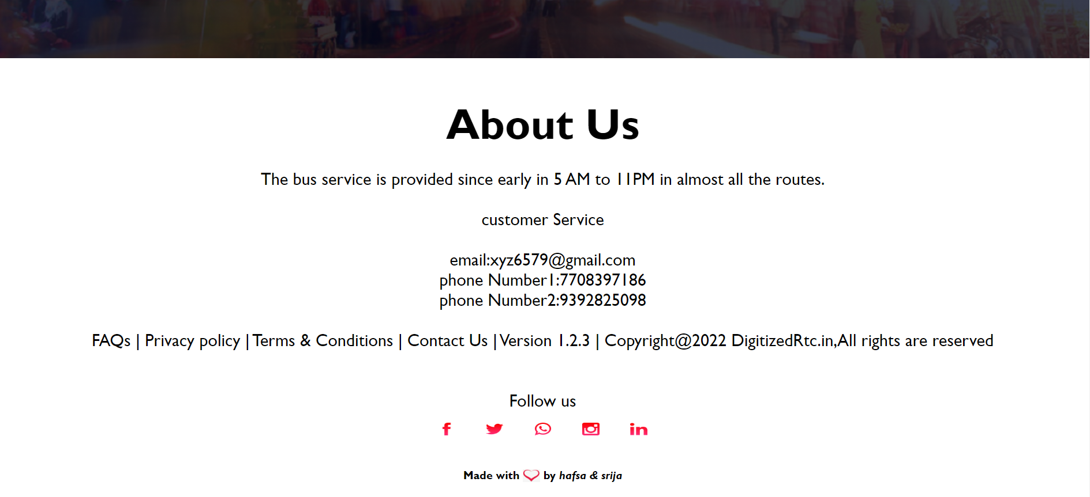

Slide 20
CONCLUSION
Digitized RTC provides a feature for users to take their intra city bus travel tickets ahead of their travel - to make the process easy and convenient as well as promote usage of digital payment methods.

Slide 21
FUTURE SCOPE
This project can be connected to Google maps API to display the source and destination, distance, and the travel time . While we weren’t able to implement this project in the form of a mobile application we would like to do that.

Slide 22
REFERENCES
https://www.tsrtconline.in/oprs-web/
https://www.ltmetro.com/
https://www.w3schools.com/html/
https://www.w3schools.com/css/
https://www.w3schools.com/js/
https://www.javatpoint.com/php-tutorial

Slide 23
THANK YOU

